Slide 1
Wikis for simple & effective documentation
Chris Ursich
NEOISF Meetup
May 2017
WARNING: This presentation contains intentionally poor grammar for the purpose of informal delivery. Reader discretion is advised.
Notes:
Hello. I’m going to tell you why I think that wikis are so great.
Why I’m INTO them
How YOU can use them to get a group of people to cooperate by writing things down

Slide 2
Bottom line
Wikis are an easy way for more,
meaningful documentation to happen.
Notes:
The point is..
Wikis are an easy way to get people to write more things down.
When I talk about documentation, I don’t just mean formal records.
The real need is for WORKING DATA: What people who are working together really need to share.
Examples:
Working list of firewalls
Installation notes for when I set up RSYNC that one time
Quickstart for various tools, like “Web interface for SolarWinds, and how to specify your credentials.”
API
Thinking of documentation as some kind of report you write at the end is all wrong.

Slide 3
Key idea
Documentation is not the fun part.
If you want it to happen,
lower the barriers to writing things down.
Notes:
Key idea is super simple.
You want
fewer steps
less time
less complicated
OK, less work is better.. That’s not a breakthrough discovery.
But I don’t think people realize the leverage of this idea. A picture helps.
I was not always the person to introduce wikis, but I paid attention to why they were unexpectedly successful. I figured out why. This is what I really though of:

Slide 4
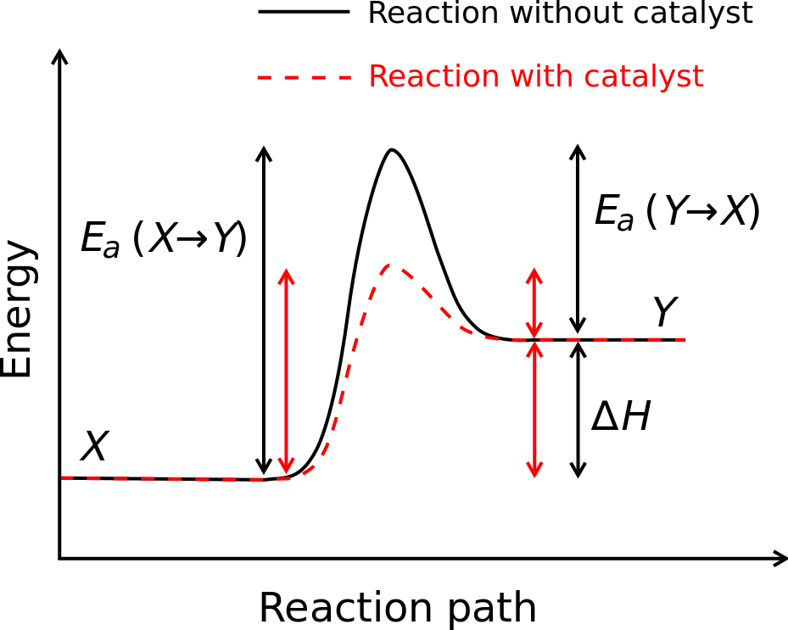
Activation Energy
Activation energy. (2017, April 17). In Wikipedia, The Free Encyclopedia. Retrieved 18:05, May 14, 2017, from https://en.wikipedia.org/w/index.php?title=Activation_energy&oldid=775842287
Notes:
Some of my training is in Chemistry.
To get from start to finish, you must add energy, do work, climb the hill.
The picture shows a catalyst– Change the mechanism, and the hill is lower.
Our goal is to be continually pushing down that hill.

Slide 5
But we do the opposite
“Documentation is important, so we will centralize it into SharePoint.”
“We’ll set up a sub-site for each team, or a directory per operating system, with permissions.”
“Use check-in / check-out revision control.”
The problem is not that too many people are accessing information, but too few!
Notes:
SharePoint.. or something like it.
SharePoint, in principle, is a wonderful product. Every implementation I’ve seen, however, is in practice just a web-access file share, with search that is somehow always broken.
Our problem is not that we need to keep people out; we are trying to bring people in.

Slide 6
“We’ll have Word templates.”
Problem description: _________________
Scope: __________________________
Diagnostic steps:
______________________
______________________
______________________
Solution:
______________________
Real problems don’t come in Lego pieces, and real work can’t be described with them.
Notes:
Real work is not shaped like this.
Instead of lowering the barrier to capturing this information, you tell the tired person to FILL OUT A FORM.
Forcing the engineer to do the extra work of re-organizing his own natural understanding of the work, so as to fit this taxonomy and “required fields” you’ve dreamed up.
If the finished product is not in the natural form of the thought, it is useless to the main person who would have cause to use it.
Forces you to do all the documentation at the end.

Slide 7
What I tell wiki users
If all you have is one sentence, URL or ticket number.. Just paste & save.
If more to say later, simply add
Don’t worry about perfect.
Markup is not what’s important
Copy syntax from other articles or Wikipedia
Write it for yourself.
You are the most likely person to read it.
“The purpose of this page is _____”
Notes:
Emphasize to do as much work as is useful, then stop.
If you write it for yourself, it will be good.
“What’s a good way to start?”
“What should I include?”
Into a blank page, type “The purpose of this page is”.. and think, and finish the sentence. Now you know what you should include. If later as you are working, you wonder whether you are drifting, just look up at the first line.

Slide 8
Comparison
Over-structured approach
Wiki approach
Platform limitations
Heavy/proprietary client tools
Users must learn to navigate the system
Loses value unless actively kept organized
Get permission, spend money
Platform-independent
Everyone already has a browser open
No training or explanation required
Search replaces pre-organization (Yahoo vs Google)
Download for free and go rogue
Notes:
Raise your hand if you’ve ever gone to Wikipedia training.

Slide 9
Comparison
Over-structured approach
Wiki approach
Promotes documenting only at the end, when you’re tired and have forgotten nuances
Documentation never seen again
Pretty, feature-rich
Mysterious revision control
Low AE promotes documenting decisions along the way, while you remember them
Notes continually useful, mainly to you. If necessary, a simple bookmark suffices.
Focus on content: meaningful words
Built-in diff
Notes:
Now, things YOU can do as a caretaker of the wiki, to help it be successful.

Slide 10
Don’t design it until after.
Let people use it however they find it intuitive, not what you think is the “right” way.
Ex: Don’t create a naming convention for articles.
Observe how people use it, then lightly organize to support those uses.
laying its foundation on such principles and organizing its powers in such form, as to them shall seem most likely to effect their Safety and Happiness.
Notes:
Instead of a naming convention, add category tags later.
If you notice that someone is consistently doing something the hard way, just walk over and say, “Let me show you a trick.”

Slide 11
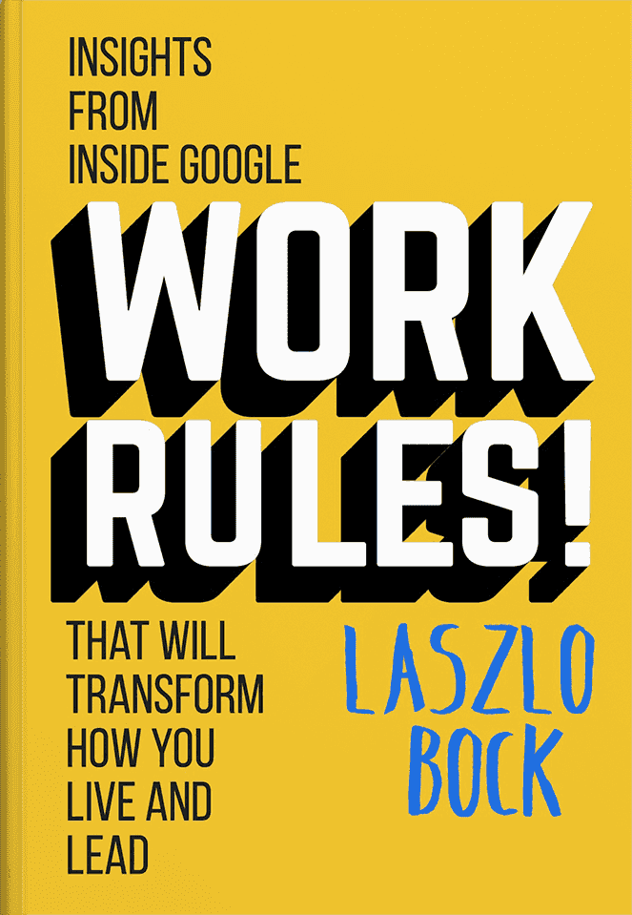
Default to open.
“Assume that all information can be shared with the team, instead of assuming that no information can be shared. Restricting information should be a conscious effort, and you'd better have a good reason for doing so.”
Chris DiBona
leader of open-source, Google
Notes:
In this book, Chris DiBona explains what “Default to open” means.
What Google does, what Wikipedia does… They seem to be doing OK.

Slide 12
But, Security!
Opposite of our security training
Principle of least privilege!
Chain of approval!
Primary risk is disclosure
All changes are tracked and undo-able.
Common sense: No passwords or secrets
Access control is possible.
Every organization is different, but in my experience, the risks are well worth it.

Slide 13
Don’t correct mistakes.
If you run the wiki, don’t correct content mistakes.
Don’t put yourself into the position of editor. No one likes being corrected. Puts emphasis onto formal correctness.
Notes:
Be the wiki COACH, not the EDITOR. No one wants their work to be put under the microscope.

Slide 14
Use positive reinforcement.
Featured Article
Look for recent changes by infrequent contributors. (Special:RecentChanges)
Transclude the article onto the main page, and give a byline.
Ex: Log rotation scheme updated by Patty
New feature weekly. Microscopic degree of effort.
Article counter
“Magic word:” {{NUMBEROFARTICLES}}
Notes:
Wikipedia has a “featured article” on the main page, so so will I.

Slide 15
Play to wiki strengths.
Simplicity is key to low activation energy and low maintenance.
Text. Some images. Maybe a PDF. That’s it.
Use plain MediaWiki.
Minimize extensions or other add-ons. (The comes-with set is probably sufficient.)
Notes:
Maybe a PDF. But at that point, you’re no longer doing documentation, you’re implementing a file share.
Plain MediaWiki:
* Very well supported; usage documentation is EVERYWHERE; skills are directly transferable

Slide 16
Weaknesses
Search is slightly wonky.
But the person who most often needs your documentation is you.
File handling is somewhat manual.
But play to wiki strengths.
Still hits a sweet spot for what
real engineers need every day

